Slide 1
Presentation
Introduction to Software Engeering
AI Group2

Slide 2
01.
Introduction
CONTENTS
02.
Main Demo
03.
Follow-up

Slide 3
Introduction
01

Slide 4
01
Overview
Background
Students will meet different people when they enter a new school, in this case, they are more likely to conflict if they live together with different life style. To avoid this from happening, our project is set to assign people with similar habits to the same dormitory.
Function
There is a roommate matching system in our project, which is designed to allocate students to the same dormitory based on their living habits such as going to bed early or staying up late at night. Students are required to fill out a questionnaire and will be matched with suitable roommates by our project.

Slide 5
01
Overview
Composition
Our project is divided into three parts, web designing, database storing and matching algorithms.
Relative information such as habit and interest can be entered and the result can be shown through the the web designing part. As for the database storing part, a MySQL database that connects to web is used to store the information with two exel tables. Then the information will be transmitted to the algorithm part to run. Finally, the result is shown in the web part.

Slide 6
01
Team organisation
In order to develop project efficiently, the team was divieded into three groups:
(1) The front-end design: two people.
(2) The back-end design: three people.
(3) The algorithm design: two people.
Project management strategy
(1) Work supervision
Group leader was appointed in each group to supervise the group process.
(2) Frequency of meetings
Twice a week.
(3) Internal procedures
A. Summary after class.
B. Discussion and Inspection before submitting updates.

Slide 7
Main Demo
02

Slide 8
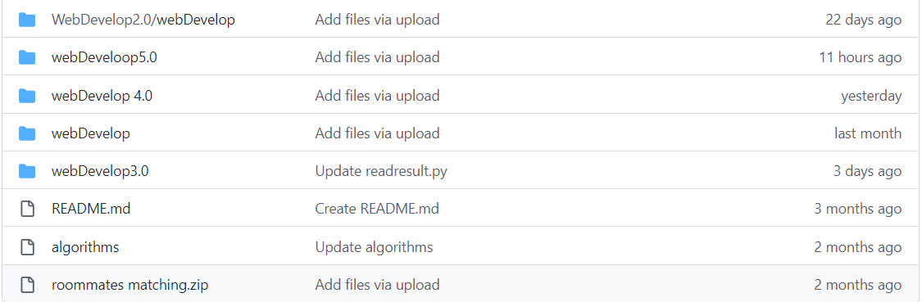
Optimization
In order to better optimize the project, we went through five versions of development, all five of which are constantly improving.
File update and optimization on GitHub

Slide 9
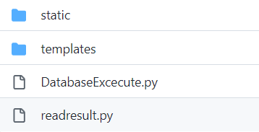
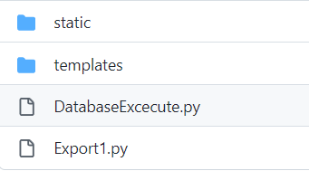
Secondary Data Files
Version 5.0
Our secondary files have realized the storage of the database, the connection between the front-end and the back-end, the display of the table and other functions.
Version 2.0

Slide 10
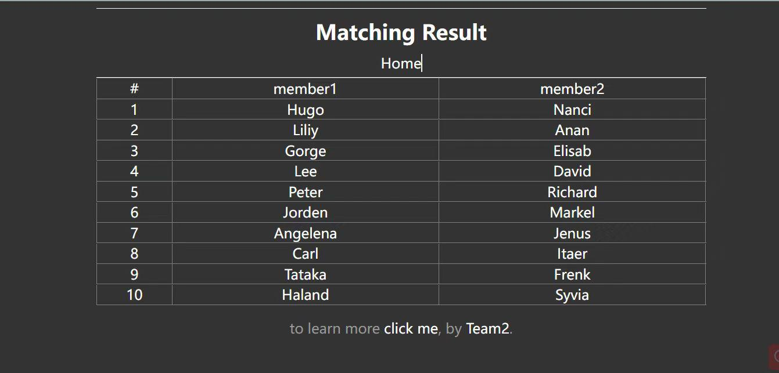
Web Presentation
In this way, the user who enters
his or her name can get an exact
matching with an appropriate
roommate.
The display page of the
matching process is shown as
the picture on the right:

Slide 11
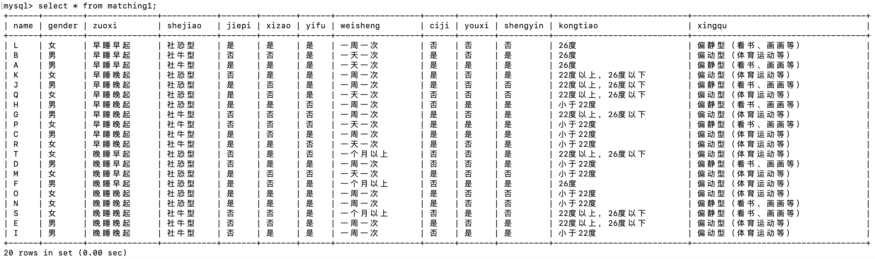
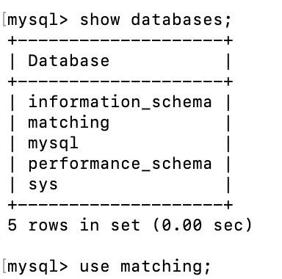
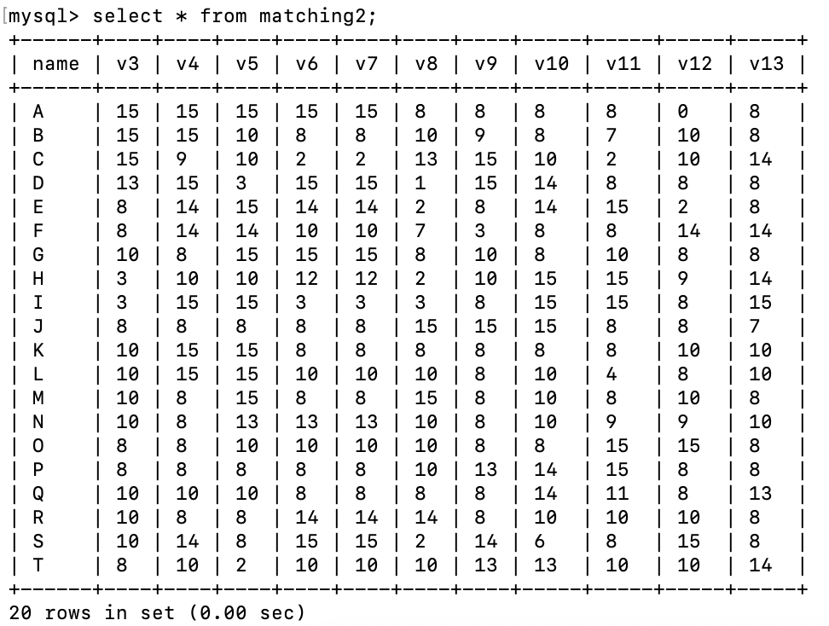
Database Storing
two tables
matching1-->the chioces selected by users
MySQL Database----open source
matching database
matching2-->the degree that users attach importance on

Slide 12
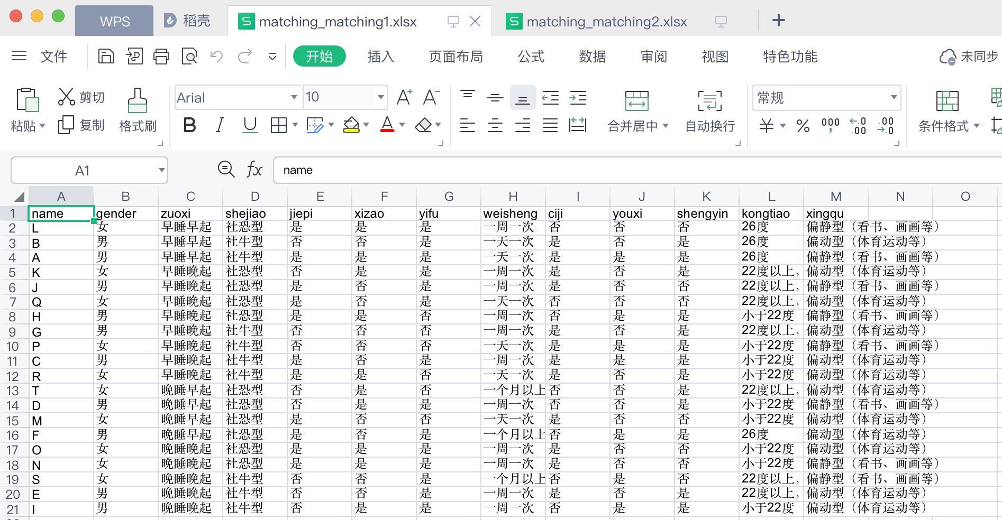
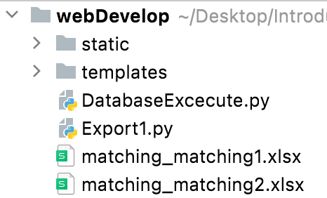
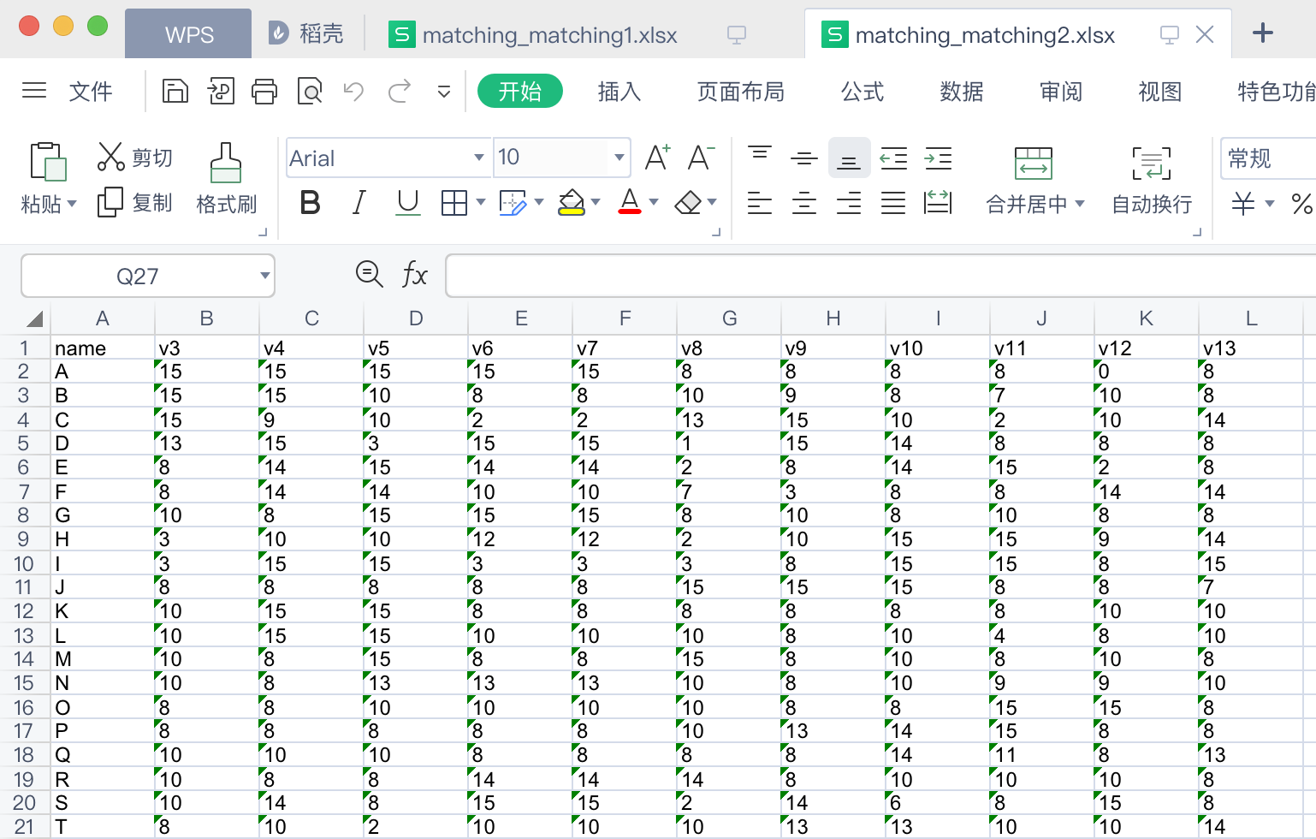
Export
matching_matching1.xlsx
Export two excel files
Transmit to algorithms program
matching_matching2.xlsx

Slide 13
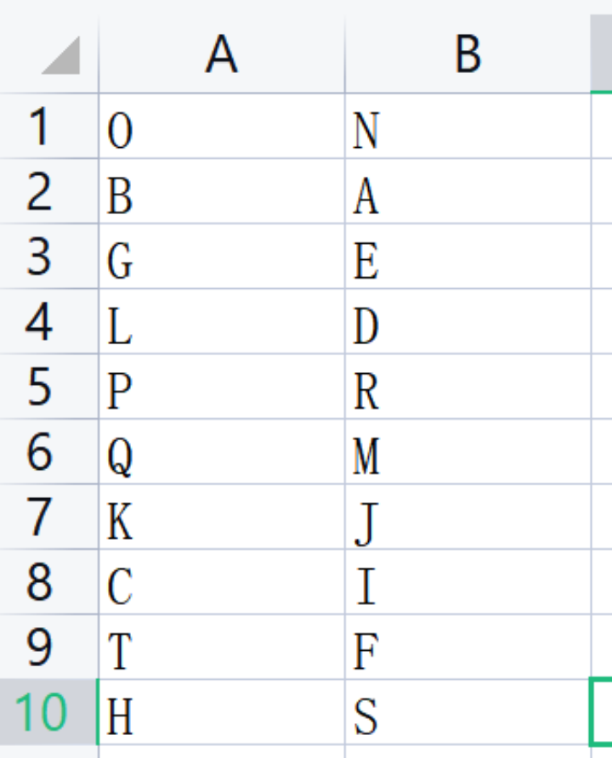
Algorithm
The second row is matching result
Work Procedures:
Import two excel files into python program and run.
The result are listed in a excel file.
Return the excel file to front-end.
Store the result in the excel file
one row represents one dormitory

Slide 14
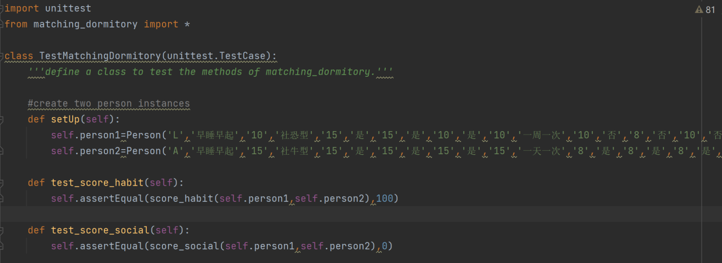
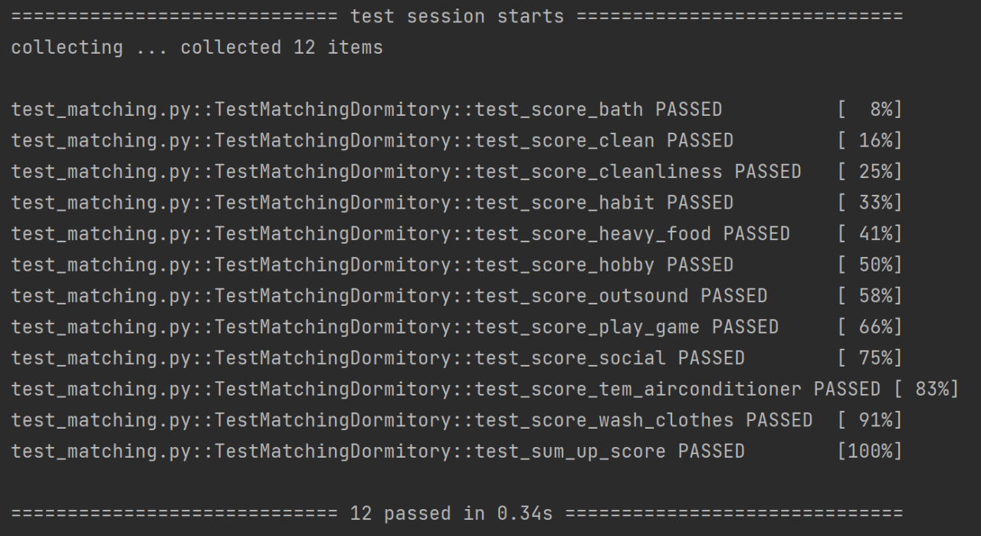
Algorithm
Testing part:
unittest is used to evaluate the availability of functions.
The program is running as expected.
All tests passed.

Slide 15
Follow-up
03

Slide 16



Follow-up
STEP 02
Building
Maintaining
overcome the major constructions and advance our web page
maintaining the source code and web pages of our project
Advertising
Promoting the accuracy and superiority of our product to users
STEP 01
STEP 03

Slide 17
Follow-up
Step | Proportion of total funds | Time
Building | 50% | The whole process
Advertising | 25% | After the production of relatively complete products
Maintaining | 25% | The whole process

Slide 18
THANK YOU

